Slide 1
Automated spend and expense management

Slide 2
Disclaimer
The information contained in this presentation or subsequently provided to any recipient of this presentation whether orally or in writing by or on behalf of ClearSpend Inc. (“ClearSpend or the Company”) or its respective employees, agents or consultants (information) is provided to the recipients on the terms and condition set out in this notice. The purpose of this presentation is to provide recipients with information relating to the Company. This presentation has been prepared by the Company and each recipient must make his/her own independent assessment and investigation of ClearSpend Limited and its business and assets and should not rely on any statement or the adequacy and accuracy of any information.
The company makes no representation or warranty (either expressed or implied) as to the accuracy, reliability, or completeness of the information. The Company and its directors, employees, agents and consultants shall have no liability (including liability to any person by reason of negligence or negligent misstatement) for any statements, opinions, information or matters (express or implied) arising out of, contained in or derived from, or for any omissions from the presentation, except liability under statute that can not be excluded.
This presentation contains references to certain intentions, expectations and plans of the Company. These intentions, expectations and plans may or may not be achieved. They are based on certain assumptions which may not be met or on which views may differ. The performance and operation of the Company may be influenced by a number of factors, many of which are outside the control of the Company. No representation or warranty, express or implied, is made by the Company or its respective directors, employees, officers, agents, consultants or advisors that intentions, expectations or plans will be achieved either totally or partially or that any particular rate of return will be achieved.

Slide 3
Small businesses have a need for spend controls and are being ignored by Divvy, Brex and Ramp
The average business loses $16,800 per year reimbursing fraudulent expenses
Notes:
I would add in the voiceover for this slide, we’re the only platform designed and built to service this market to offer this type of financial automation and savings to the customer.

Slide 4
Need for Spend Control & Expense Management
US CORPORATE CARD
Expense management from the perspective of finance professionals
72%
90%
31%
86%​
of finance professionals report expense processing as the most frustrating part of their job as they spend 55 hours per week on expense management​
of companies are allowing employees to expense new items due to the pandemic​
of finance professionals report that more employees are submitting expense reports than they were pre-pandemic​
of finance professionals want to automate spend management processes
Association between business fraud and expense control
14%
$16,800
33%
36%
of business fraud losses are tied to expense reimbursement
median annual loss per business caused by expense fraud
of businesses process expense claims manually via pen and paper or spreadsheet
of US & UK businesses plan to upgrade spend management and expense controls

Slide 5
ClearSpend eliminates fraud & financial waste through real-time card transaction control and expense management.

Slide 6
Getting Started
HOW WE COMPARE
21+ days
Time to underwrite a deal
20 minutes
4-5 days
Account accepts funds
Real time
7+ days
Customer receives card
72 hours
Slow & Built for the enterprise
Fast & Built for SMBs

Slide 7
Signing Up Process for ClearSpend
Owner issues cards, sets spend controls,
& monitors spending
Employee enters transaction details & uploads receipts
Business Owner
Signs up for a ClearSpend Account
Employee
Receives virtual and/or physical card for business spend
Bookkeeper
Transactions and receipts are pushed into QuickBooks, simplifying reconciliation
Business Owner:
fund account
create allocations
issues cards
set spend controls
monitor spend
Employee:
Receive card
Use card
Upload receipts
Enter transaction details
Bookkeeper:
Pull fields from QB into the mobile app
show QB to the mobile app
mobile app back to QB
Business Owner
Employee
Bookkeeper

Slide 8
Real-Time Spend Management
MITIGATING FRAUD AND AUTOMATING EXPENSES
Business defines rules based on their own expense policies
Business can issue physical and virtual Visa cards to employees
Banks or Issuer Processor Network
SMB / Customer
Transaction is either approved or declined in <2 seconds based on expense rules​
ACH | RTP*
Platform requests mobile receipt upload in real-time
Customer’s Existing Bank
Expense report submission & approval
Integration to accounting platforms like QuickBooks Online and Desktop
* RTP needs to be supported by customer’s bank

Slide 9
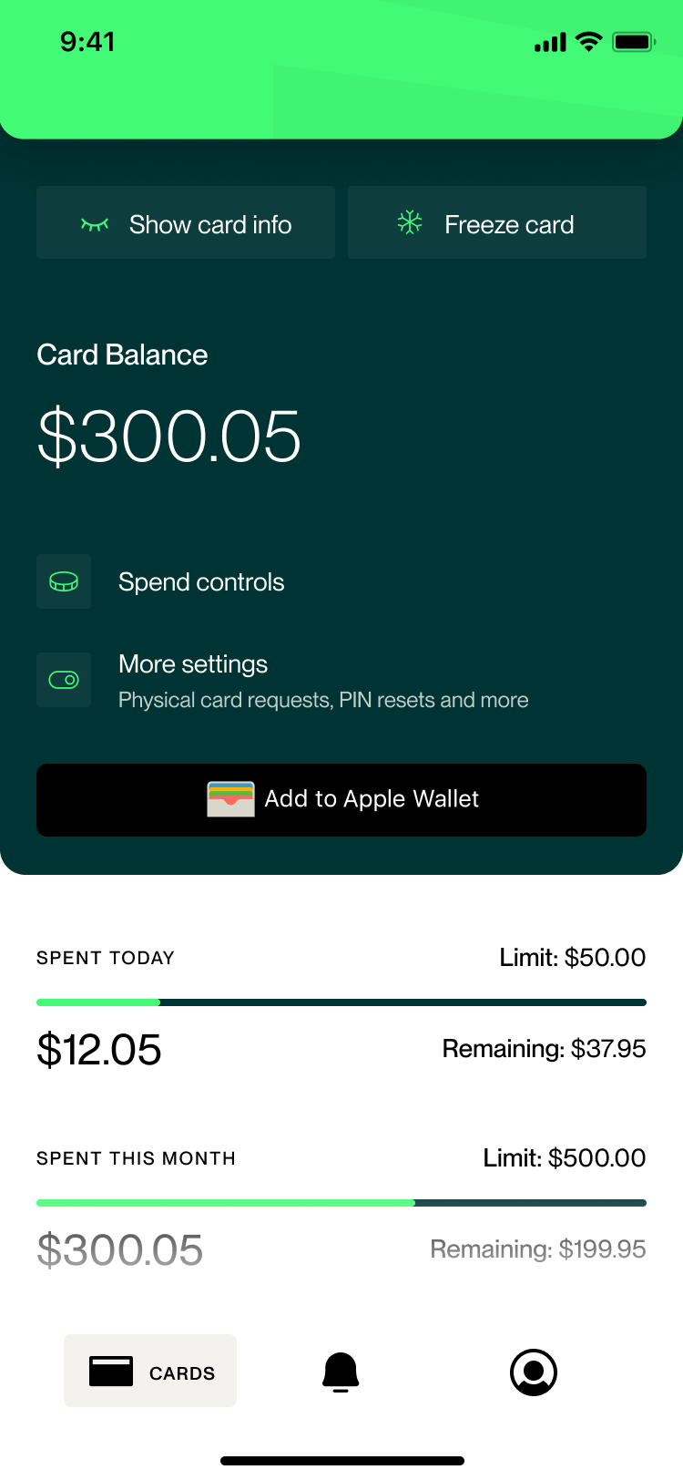
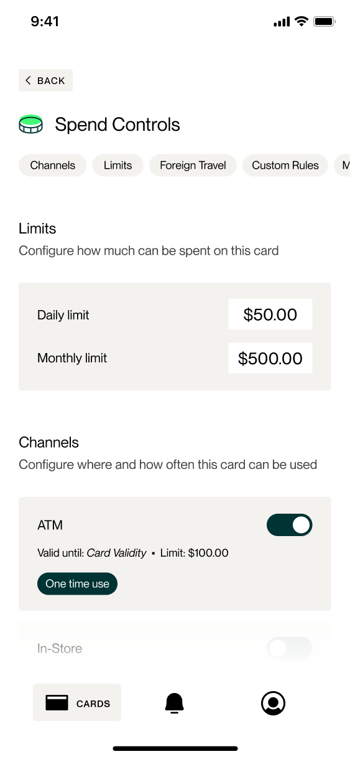
Admin Mobile Application
US CORPORATE CARD
Card Info
Spend Controls
Edit Limit Amounts

Slide 10
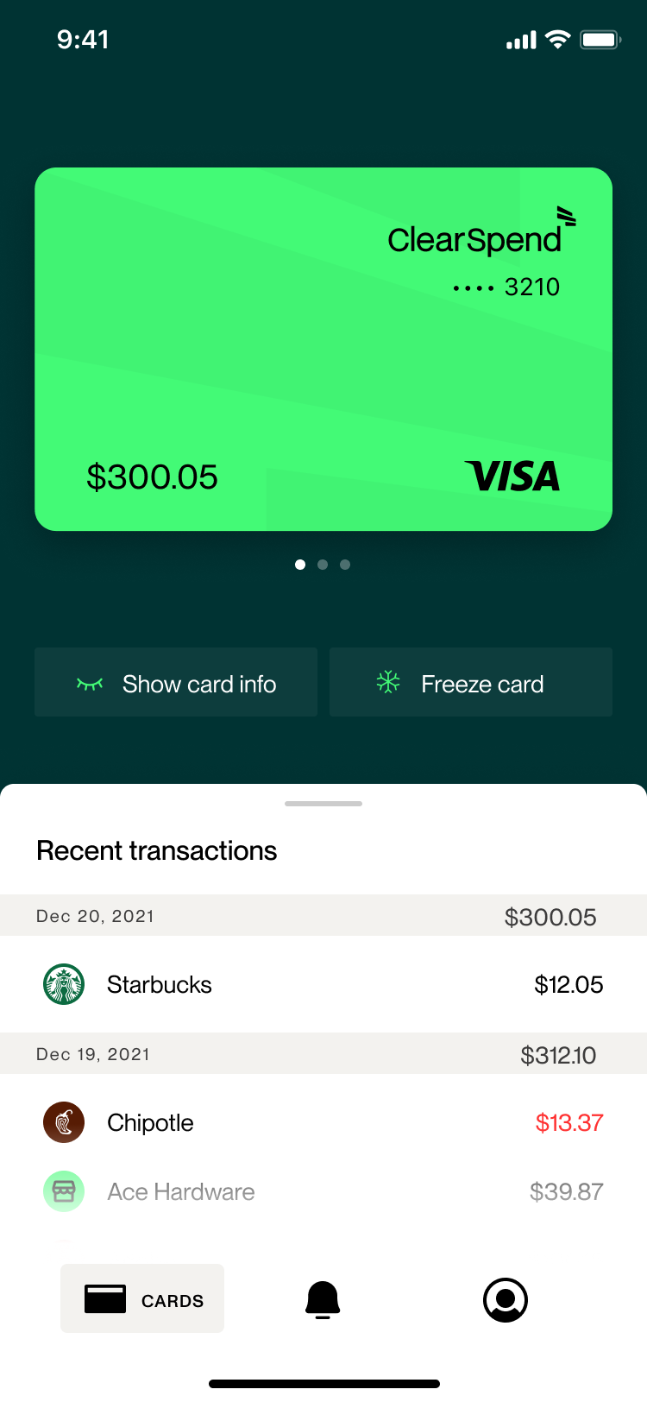
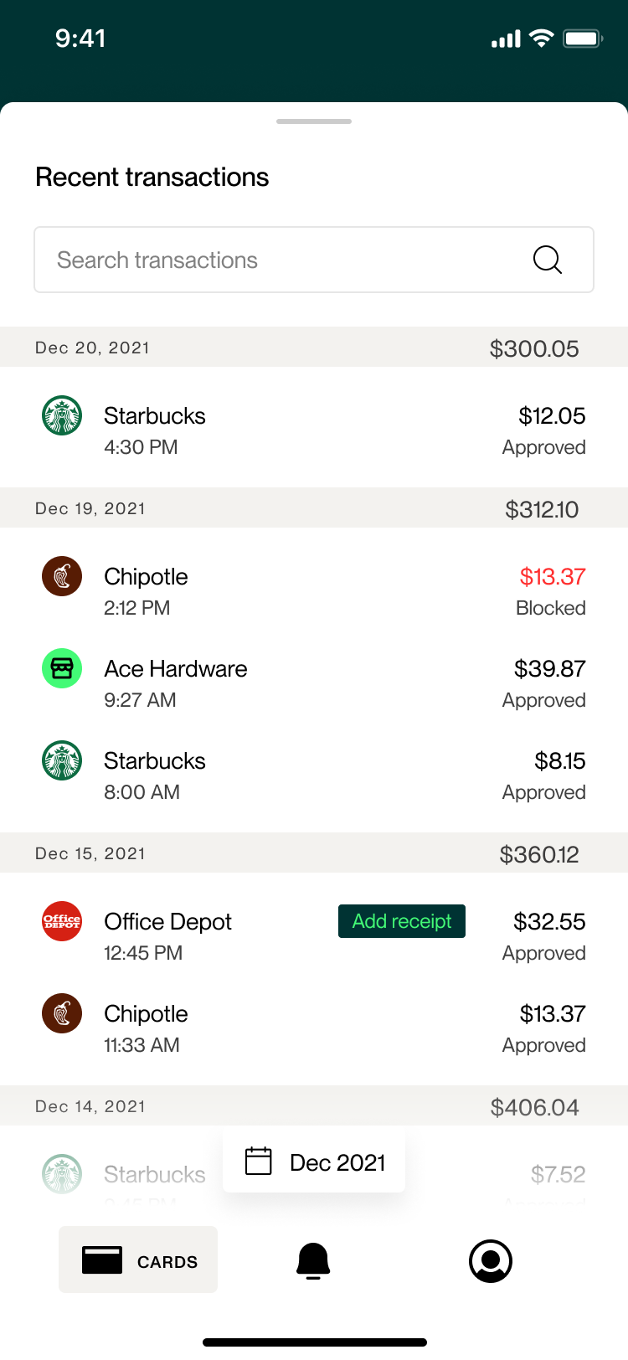
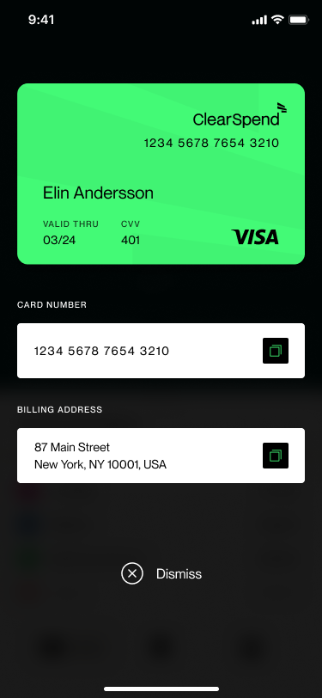
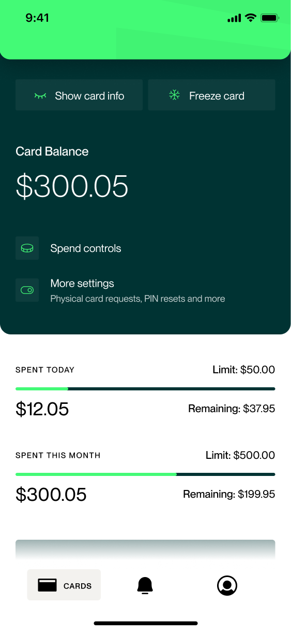
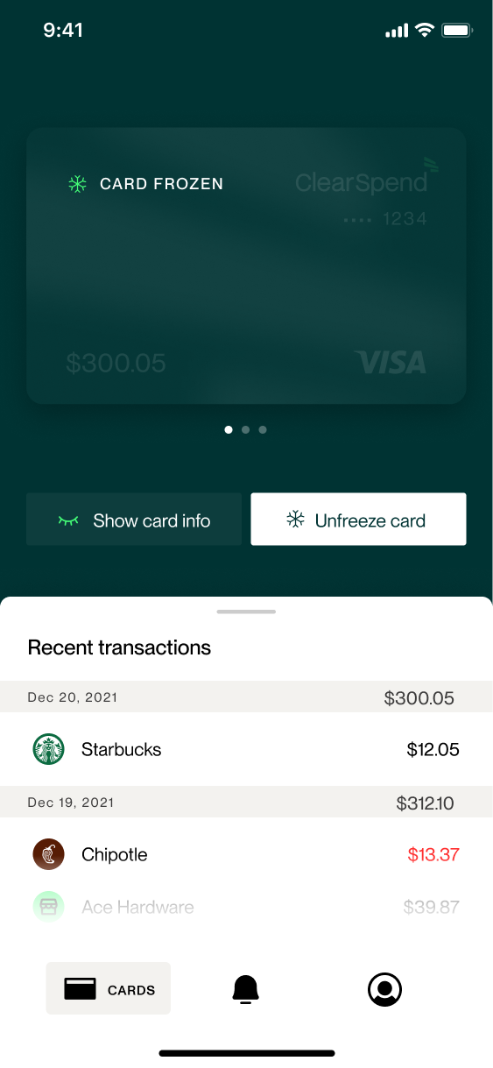
Cardholder Mobile Application
US CORPORATE CARD
ClearSpend Card
Card Transactions
Card Info
Card Details - Controls
Added to Apple Wallet
ClearSpend Card Frozen

Slide 11
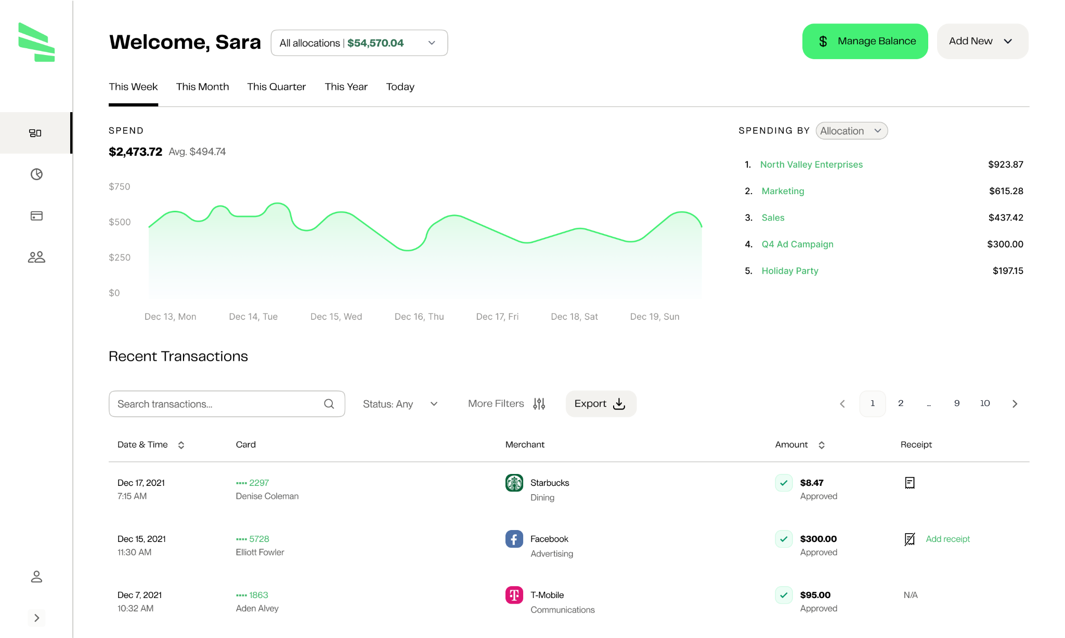
Admin Dashboard
US CORPORATE CARD

Slide 12
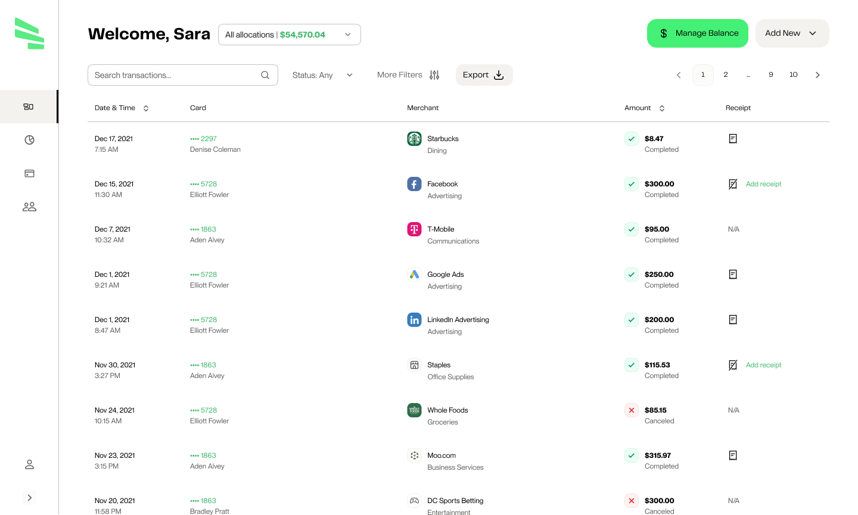
Transaction Reporting
US CORPORATE CARD

Slide 13
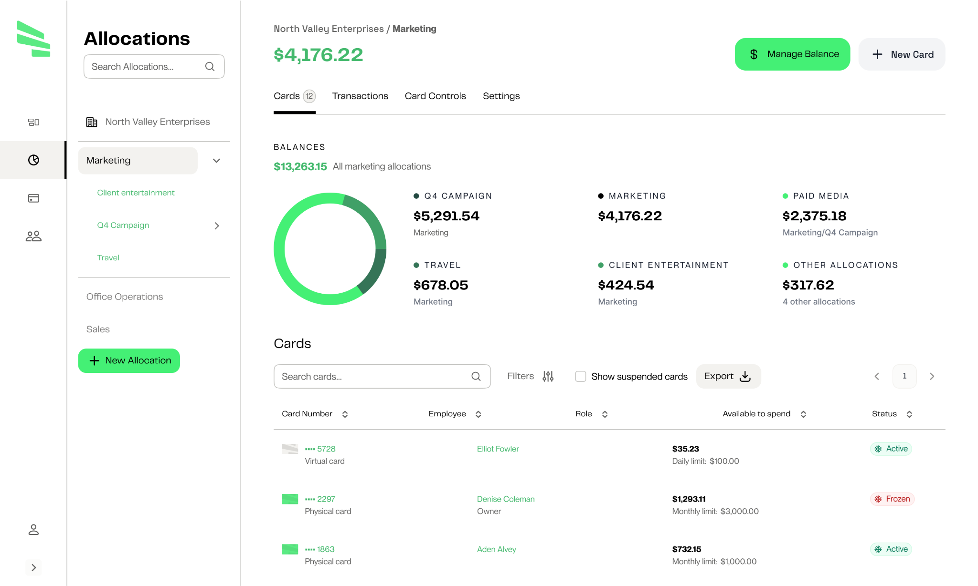
Budget Management
WEB INTERFACE

Slide 14
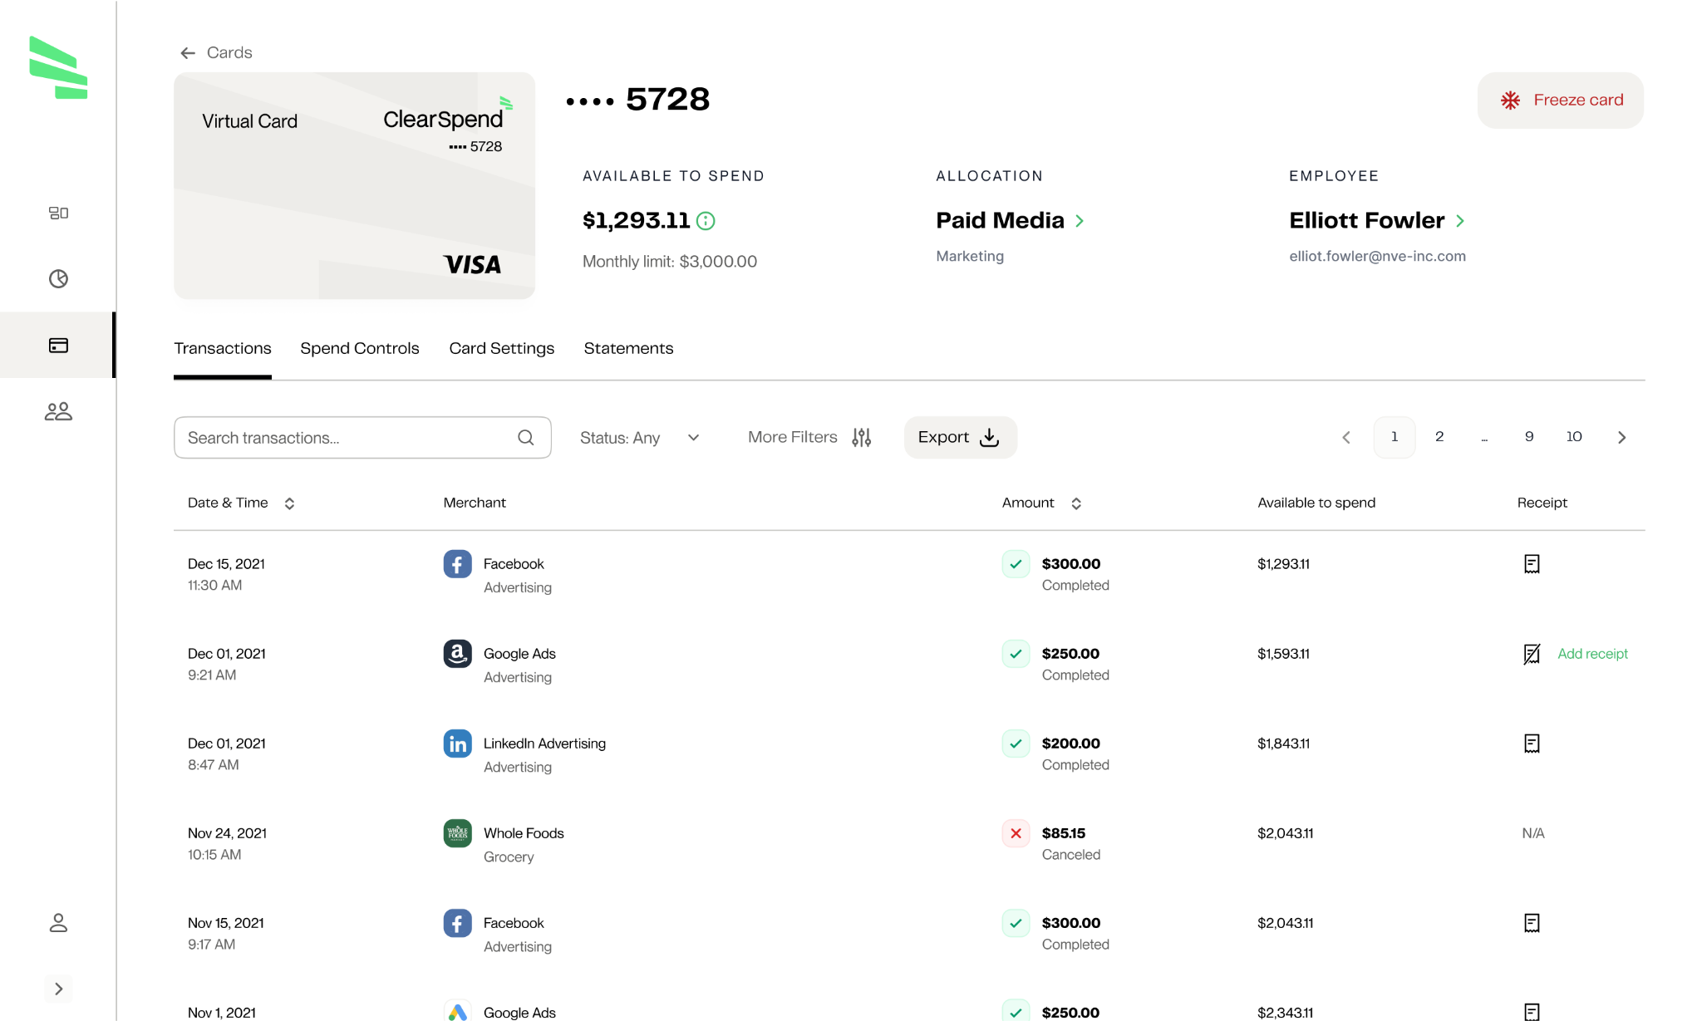
Card Use Monitoring
US CORPORATE CARD

Slide 15
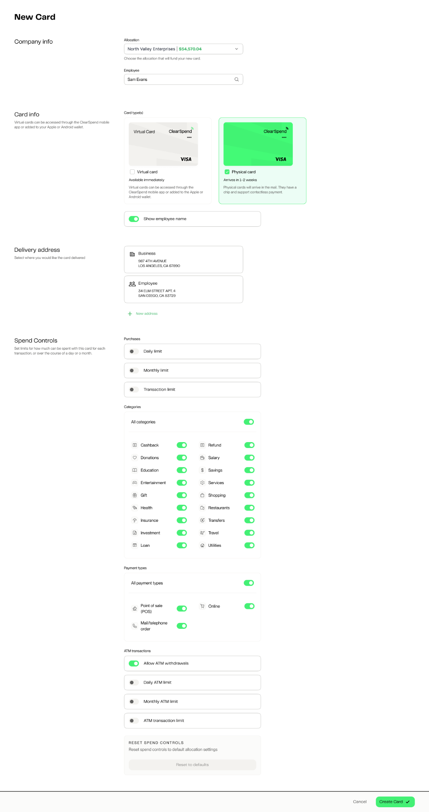
Card Management
US CORPORATE CARD
Spend Limits
Transaction Limits
MCC Restrictions
MID Restrictions
Geographical Restrictions
Channel Restrictions

Slide 16
$52 USD
REVENUE DRIVERS
Business Model
SME Customers
Share of Interchange (% of customer spend)
Up to 2.65% interchange on
commercial cards
Working Example
1 Customer | 10 Cards Issued | $36,000 Annual Spend per Card
$360,000 annual spend
x 2.40% average Interchange
-0.50% processing cost
=$6,840 net revenue
Annual revenue
@ 10,000 SME customers
$68,400,000

Slide 17
OUR COMPETITION
Competitive Landscape
Founded
2017
2019
2016
Current Valuation
$12.3B
$8.9B
$2.5B
Series A Fundraise
$6.5M
$7M
$10.5M
Pre-Money Valuation at raise
$18.5M
$25M
$50M
Business Stage at Series A
Developing Technology
Developing Technology
Developing Technology
Revenue at Series A Raise
No Revenue
No Revenue
Revenue Generating
Competitive Landscape
Focused on tech, life sciences, and e-commerce
$49/month subscription for spend control features
Focused on large businesses and well-funded startups with significant cash on hand
Require proof of cash reserves from $75K-$250K
Focused on credit-worthy businesses
Only issue credit cards requiring credit check, no debit option

Slide 18
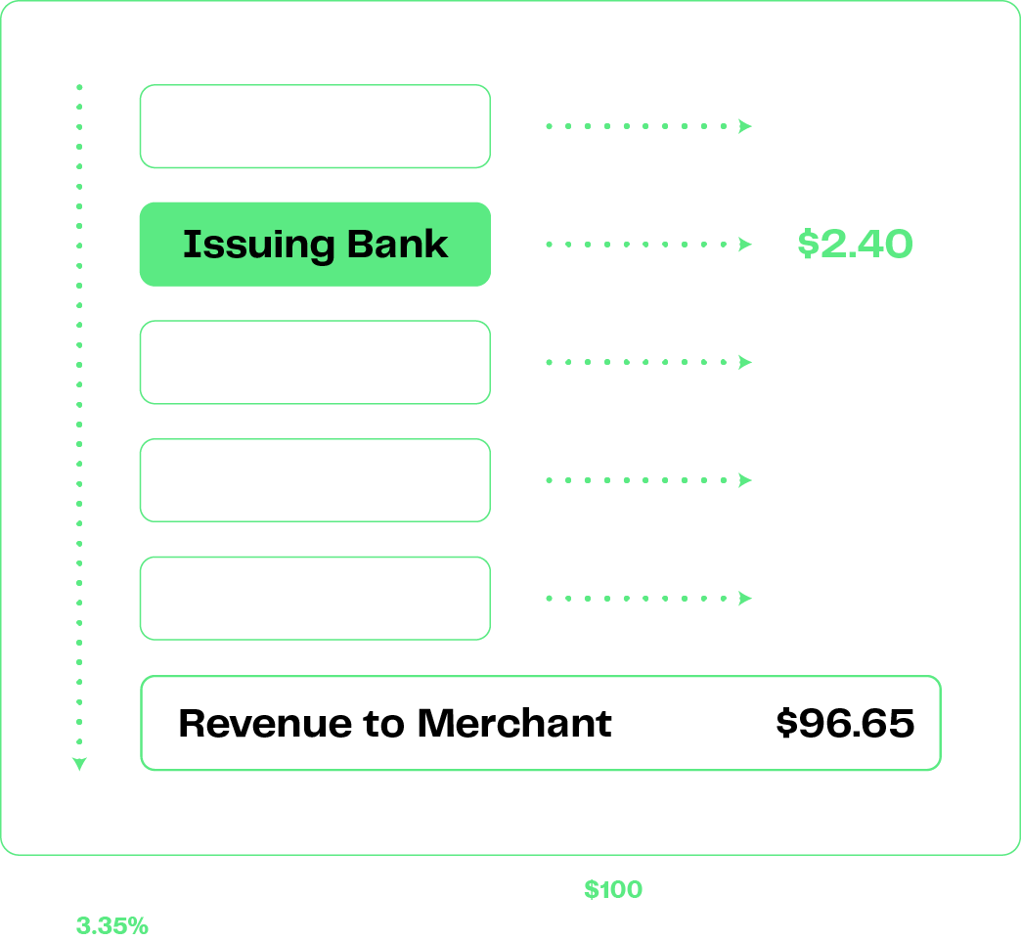
How interchange works
ClearSpend = Issuing Bank
We make the lion’s share of the revenue in the transaction flow.
Rates can vary but we average 2.4% on most transactions.

Slide 19
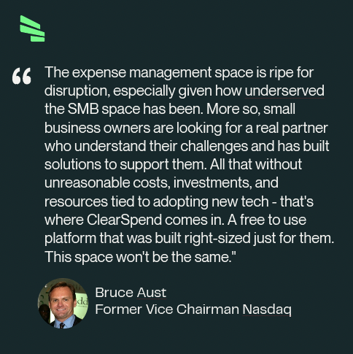
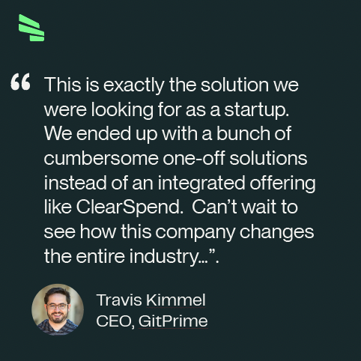
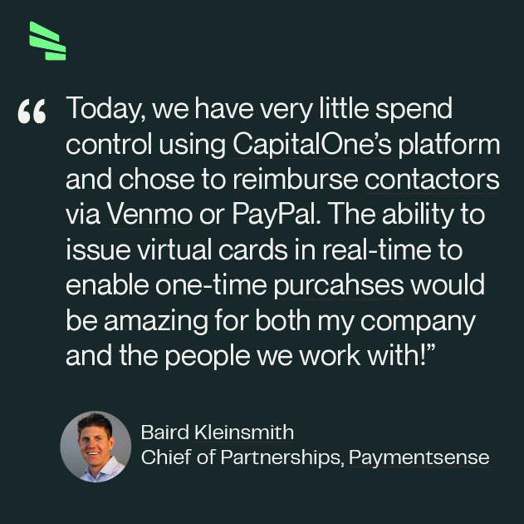
Word on the street

Slide 20
Stripe Endorsement
“Stripe is excited to support ClearSpend and their mission to empower small businesses with a reimagined approach to expense and spend management. Stripe’s Treasury and Issuing APIs will enable ClearSpend to hit the market faster with a superior solution for the countless small businesses that need it.”
- Denise Ho, Head of Product for Banking-as-a-Service (BaaS) at Stripe

Slide 21
AngelList Endorsement
"We're excited to be investors in ClearSpend. We believe that exceptional people make exceptional companies and we know from our data that ClearSpend ranks in the 99.9th percentile of startups hiring on the AngelList platform in terms of interest from top job applicants.
- Abraham Othman, PhD, AngelList Early-Stage Quant Fund

Slide 22
Assessable Market Focus
First 6 Months - Focus on the 2-19 employee market with our Commercial PrePaid Card Program
Year 1 - Go upstream in the serviceable market with a Commercial Credit Program
Year 2 & Onward - Expand product offerings to EWA, Banking, Lending, Buy Now Pay Later
Total Market
Year 1 Market
630k SMBs With 2-19 Employees
Serviceable Market
6M SMBs With 2-500 Employees
Total Market
30M Small Businesses

Slide 23
Go-to-market Strategy
TAKING THE CORPORATE CARD TO MARKET
Customers will be acquired initially through three primary sales channels to be refined based on CAC, LTV, and break-even metrics.​
Direct Sales
Channel Sales
Digital Marketing
Outbound
QuickBooks Accountants
Keyword Advertising
Direct Mail
Trade Associations
Marketplaces
Tradeshows
Payment Acquiring Agents
Social Media Ads

Slide 24
Management Team
EXPERIENCED & PASSIONATE
Jeff White | CEO
Utkarsh Agarwal | CTO
Nate Meadows | Head of Marketing
Jeff Pittelkau | Head of Product
Jeff White leads ClearSpend as the Chief Executive Officer and brings over 21 years of embedded finance and payments industry knowledge. Jeff has owned and sold multiple fintech related businesses over the past 21 years. Prior to joining ClearSpend, Jeff served as Chief Revenue Officer for Rocket Matter which was acquired by Greater Sum Ventures. He then was promoted to Vice President of Payments of the holding company between Lightyear Capital and Greater Sum Ventures known as ProfitSolv where he was responsible for overseeing the company’s ongoing embedded finance strategy.
Utkarsh Agarwal leads ClearSpend as the Global Chief Technology Officer. Prior to joining ClearSpend, Utkarsh served as the Vice President of Engineering at Bakkt, which was majority owned by Intercontinental Exchange (ICE) the parent company of New York Stock Exchange (NYSE) where he was responsible for leading engineering, architecture, quality assurance, mobile app development and agile practices for the Bakkt consumer app as well as the entire payments platform for Bakkt. Bakkt announced that it was going public via merger with SPAC VPC on Jan 11th, 2021.
Nate is a B2B marketing leader – his most recent notable achievement was growing Taos, MSP, revenue 100% in 9 months ($75MM to $150MM) with complex strategic marketing initiatives. Nate brings over 18 years of multi-industry marketing experience and has worked for some of the most notable Fortune 100 companies. Further, Nate is an Air Force Veteran, holds an MBA from American Military University and post graduate work at Cornell University in Strategic Marketing.
Jeff brings more than 15 years of experience leading product teams to deliver first-to-market solutions in fintech, payments, and adtech. He joins ClearSpend from Bakkt, where he managed product leads for the Bakkt app and prepaid virtual card. Prior to that, he developed digital wallet and payment solutions for onsite amenities at Westfield shopping malls in the US, UK, and AU markets for Westfield Retail Solutions and OneMarket. He co-founded JiWire / Ninth Decimal, recently acquired by InMarket, where he led content strategy and development. Jeff holds a BS in Mathematics with Computer Science from Harvey Mudd College.

Slide 25
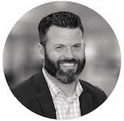
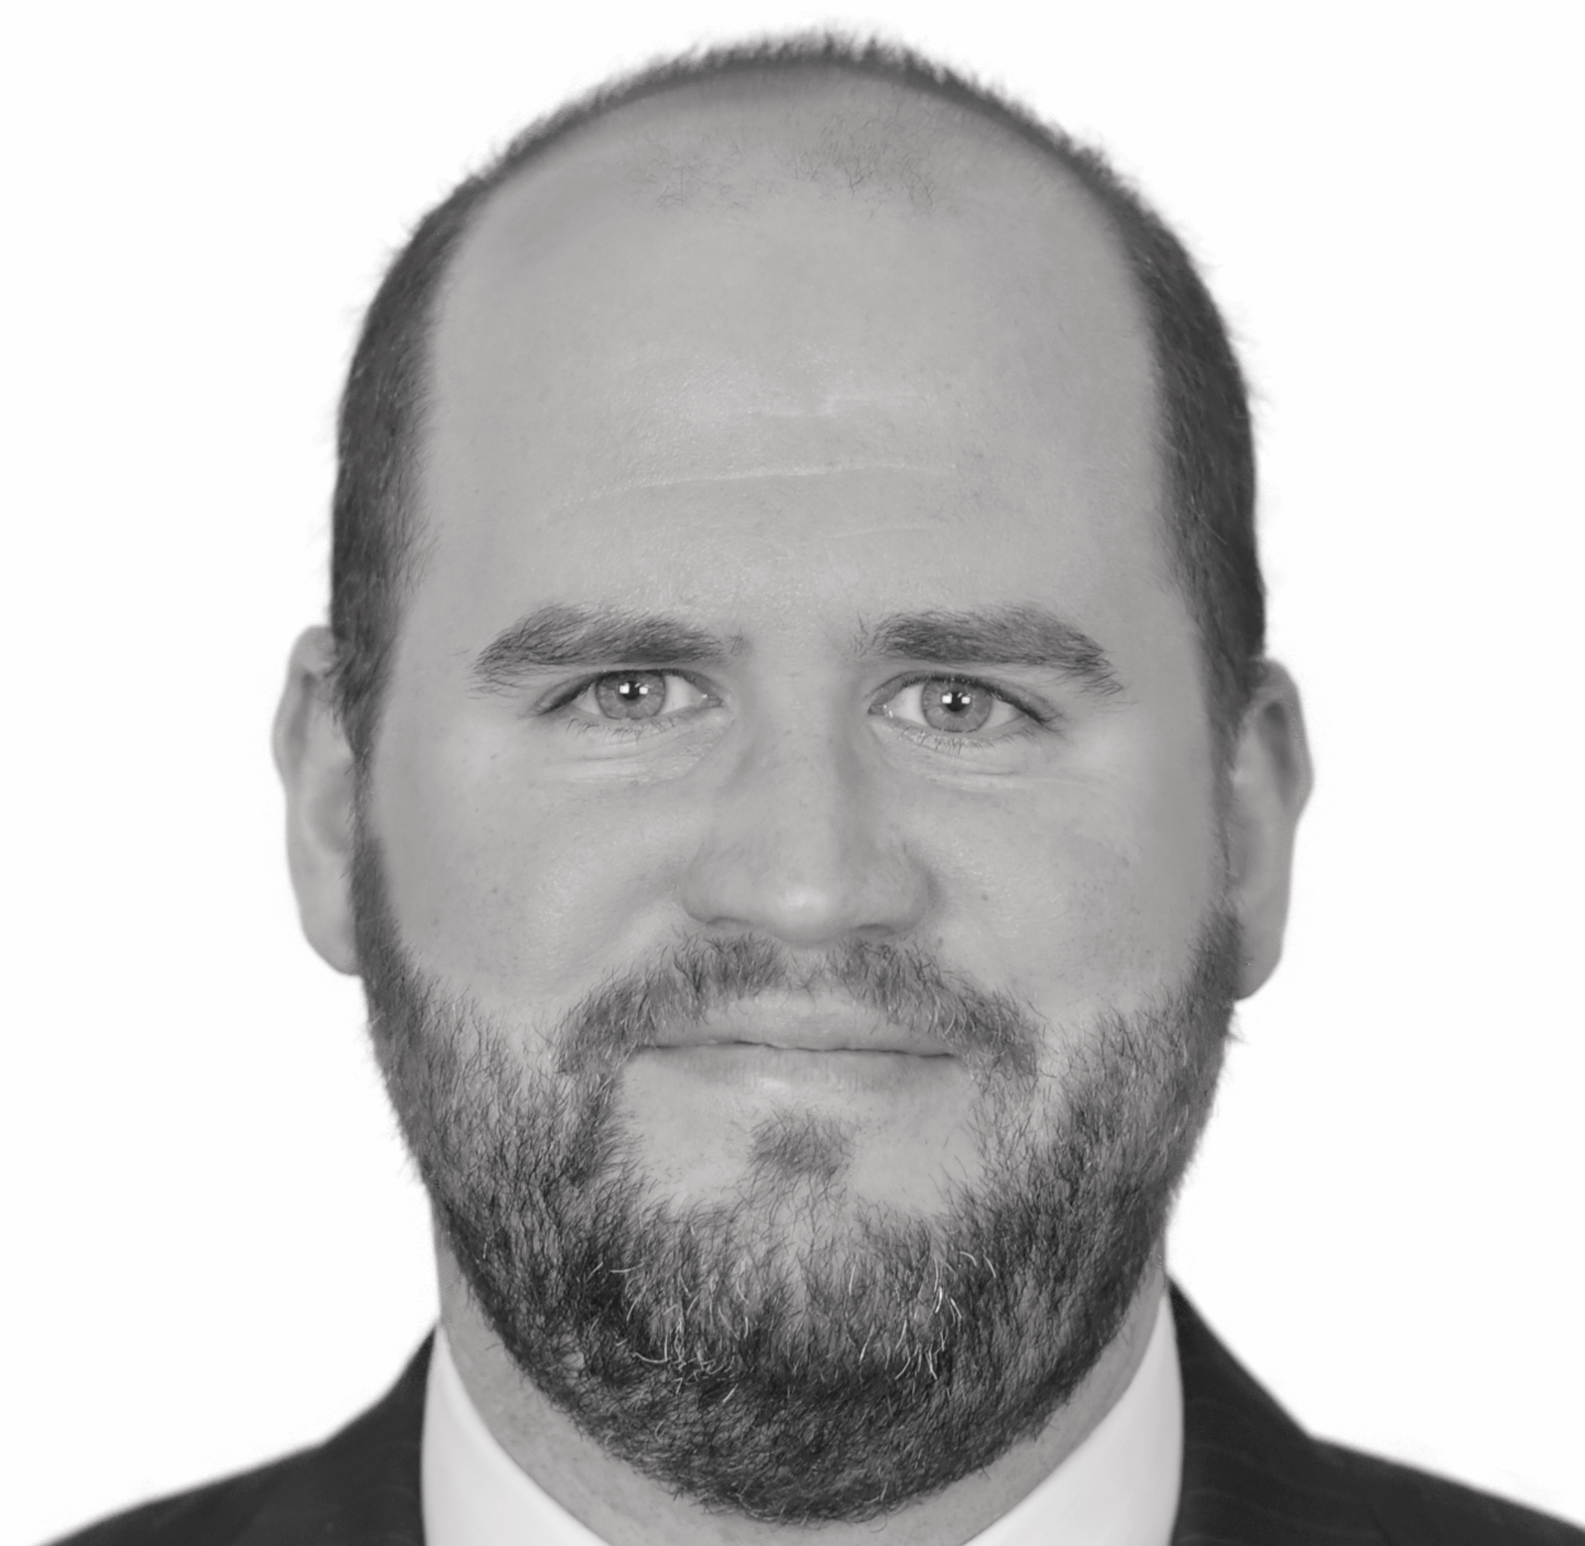
Our Team

Slide 26
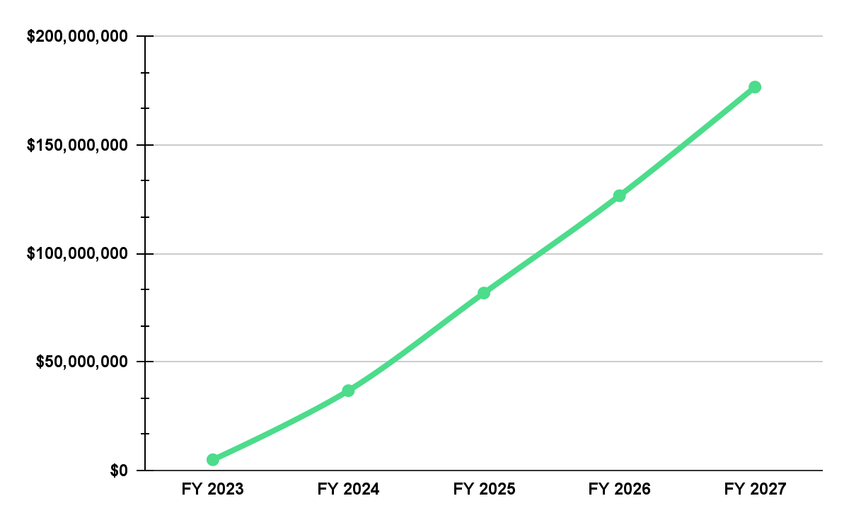
Revenue Projections
$176M
Key Summary
3 Year Ramp to 39k Net Customers
Modeled for high churn based on SMB Market
Processor costs reduced to 0.30% with increased Volume

Slide 27
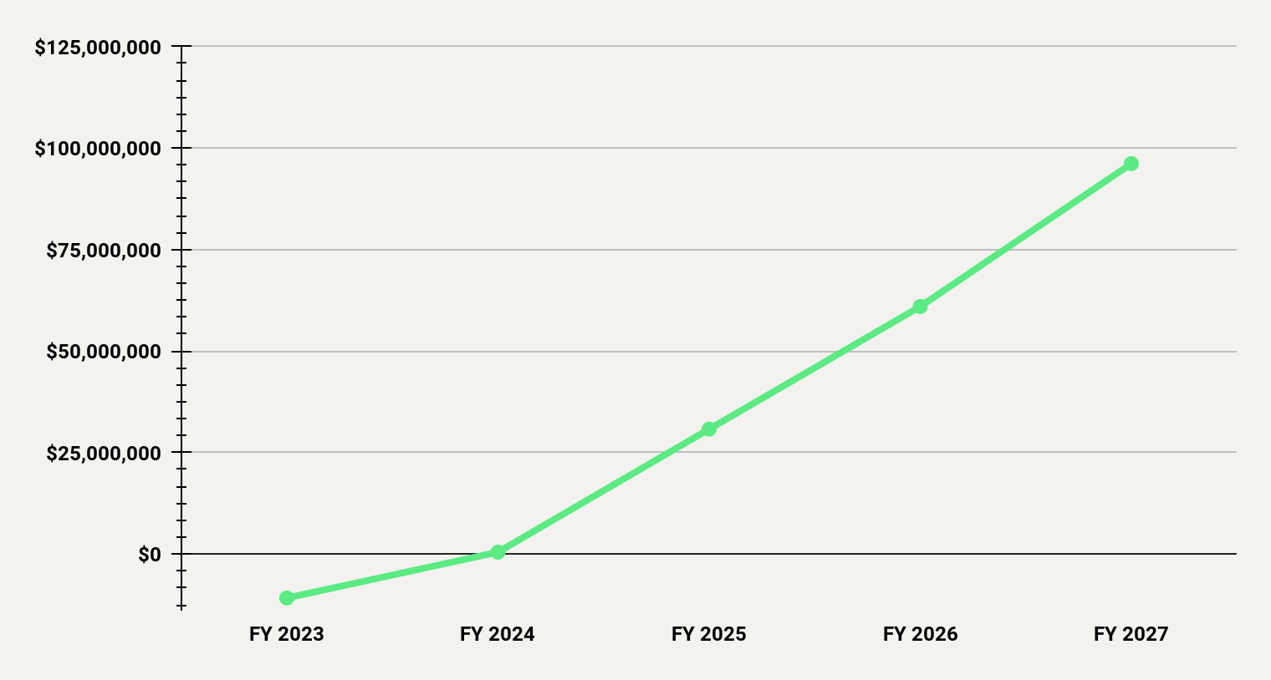
EBITDA Highlights
$96M

Slide 28
$52 USD
TODAY & FUTURE FOCUS
Current Status
Lending
AR Payment Processing
Earned Wage Access
Expense Management
AI Savings Service
Business Banking
Accounting Integrations
Commercial Credit Card
Commercial Debit Card
Bill Payments
Spend Controls
BETA
LAUNCH
2022 | 2023
LAUNCH
Q1 2022
Q2 2022
Future Opportunities
ALREADY REGISTERED 130+ Bookkeepers and Accountants
50+ SMB Owners

Slide 29
Summary
THE CONCLUSION
Robust Economics
Strong Team
Value Triggers
Proven interchange revenue model is lucrative and provides solid ramp
Strong team with deep payments and capital market experience​
Interchange driven freemium style solution providing small businesses a zero cost spend platform
Strong Distribution Model
Economic Advantages
Combination of Channel, Direct and Digital provides a solid competitive advantage
Minimized processing costs that reduces with increased with payments volume.

Slide 30
Smart spend and expense management
Jeff White | CEO
ClearSpend
+1 704 796 0283
jeff.white@clearspend.com

